Slide 1
Multilayer Perceptron
Supervised Learning

Slide 2
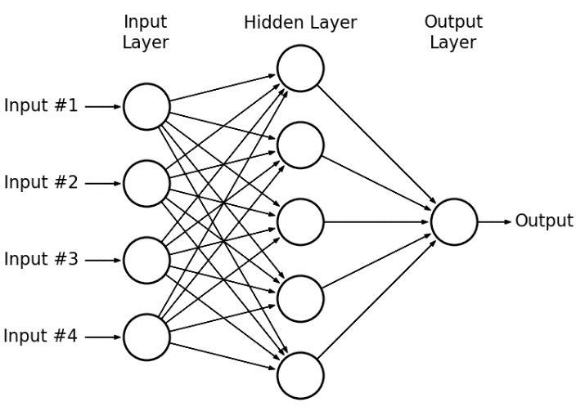
"Vanilla" neural networks

Slide 3
More on MLP..
An MLP consists of at least three layers of nodes: an input layer, a hidden layer and an output layer. Except for the input nodes, each node is a neuron that uses a nonlinear activation function. MLP utilizes a supervised learning technique called backpropagation for training.
Why do we need Non-linear activation functions?
A neural network without an activation function is essentially just a linear regression model. The activation function does the non-linear transformation to the input making it capable to learn and perform more complex tasks.

Slide 4
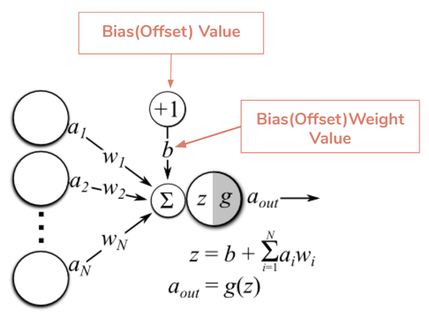
Weights and Bias
The weights and bias are possibly the most important concept of a neural network. When the inputs are transmitted between neurons, the weights are applied to the inputs and passed into an activation function along with the bias.

Slide 5


More towards Activation function

Slide 6
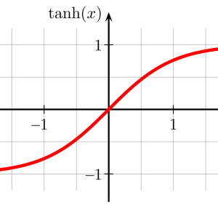
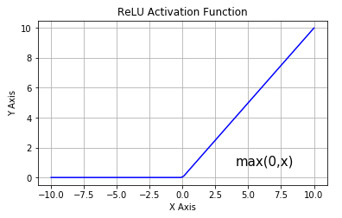
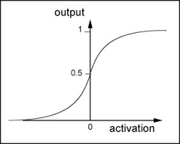
Various activation functions
Sigmoid
Tanh
ReLU

Slide 7
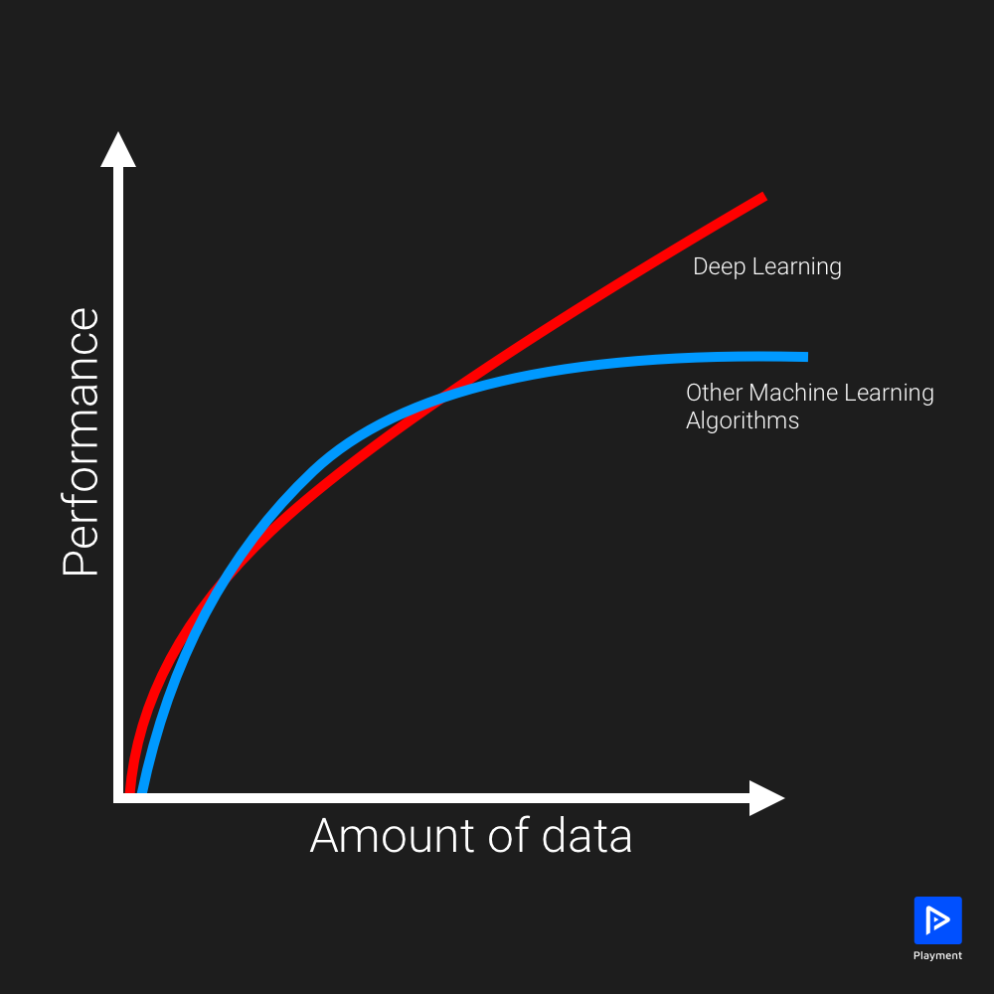
Why deep learning?

